Slide 1
JASPER S. LEE, PhD (he/him)
AMELIA M. STANTON, PhD
STEPHAN RABIE, PhD
YANGA TSHUKUSE
JOANNE HOKAYEM
CHRIS CARNES, PhD
CONALL O’CLEIRIGH, PhD
JOHN A. JOSKA, MBCHB
PETER R. CHAI, MD
Tough pill to swallow? Preliminary attitudes toward the Digital Pill System among pregnant and postpartum people with HIV in South Africa

Slide 2
Funding for this project came from Peter Chai and the Brigham and Women’s Hospital Department of Emergency Medicine
Dr. Chai’s time is funded by DP2DA056107, the Kenneth H Mayer Fellowship at Fenway Health, and R25DA058490.
No COIs to disclose

Slide 3
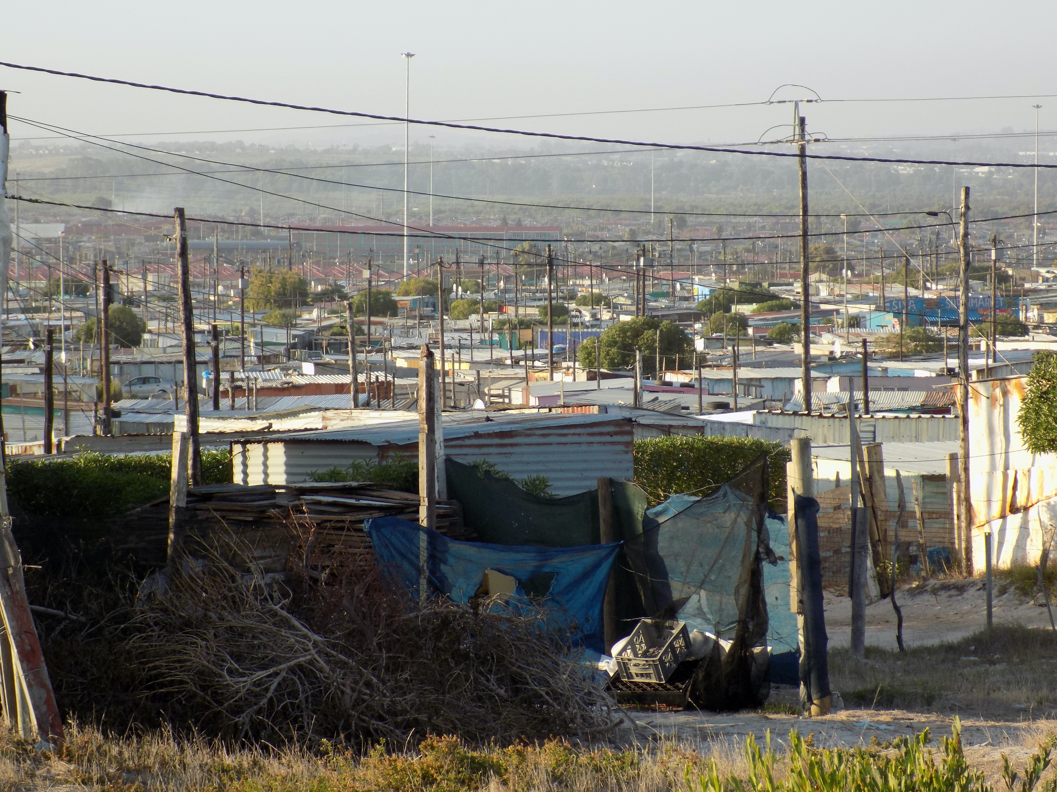
South Africa has the largest number of people with HIV (PWH) in the world
01
HIV prevalence of 19.1%
02
79,000 AIDS-related deaths in 2020
UNAIDS 90-90-90 goals: 15% of PWH in SA do not know their status, 30% are not on antiretroviral therapy (ART), and 12% have unsuppressed viral load
03
CDC, 2021; Simbayi et al., 2017
Notes:
Comment on ART and VL

Slide 4
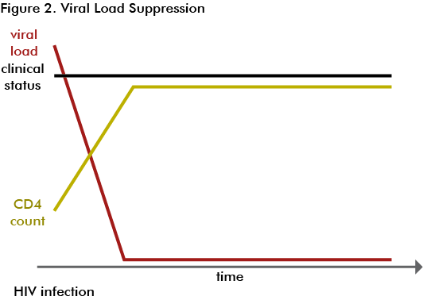
One strategy to prevent HIV transmission is through effective ART treatment
01
ART is now a once (or twice) daily single pill
When taken regularly, ART can prevent replication of HIV in the bloodstream
02
Effective ART treatment results in a viral load (copies of HIV per mL) that is so low, it cannot be detected
03

Slide 5
Undetectable
=
Untransmittable
When PWH achieve undetectable viral load, it is not possible to transmit HIV to another person through sex
01
One key time period for HIV transmission prevention is in and around the time of pregnancy, when the risk of transmission is very low (though not zero)
02
CDC, 2021

Slide 6
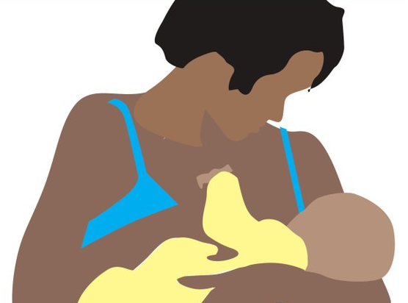
Preventing mother-to-child transmission (PMTCT) requires daily medication adherence during pregnancy and while breastfeeding
The number of pregnant PWH taking ART has increased from 14% to 84% in sub-Saharan Africa in the past 10 years
01
02
Psychological, social, and structural factors lead to worse adherence among PWH
In the context of non-adherence (and detectable viral load) the risk of perinatal infection is high
03
SSA Regional Snapshot; Psaros et al., 2020;
Matthews et., 2020; Momplaisir et al., 2021

Slide 7
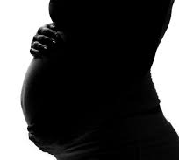
Risk of mother-to-child transmission during pregnancy, labor, delivery, and breastfeeding is 15% - 45%
As such, this discrete time period (pregnancy and post-partum) represents an important time to focus treatment as prevention efforts
01
With increased ubiquity of technologies and smartphones in SA, there is renewed interest in utilizing technological advances to measure adherence
02
Current approaches to adherence measurement are generally indirect measures (e.g., that a pill container has been opened), or direct measures that verify the presence of drug in biological matrices (these are expensive and not timely)
03
WHO 2019; Hodes et al., 2020; Osterberg & Blaschke, 2005

Slide 8
The Digital Pill System (DPS) is one way to directly measure adherence
DPS is an ingestible radiofrequency emitter that overencapsulates a single dose of ART to directly measure adherence
01
Our team has used DPS to measure adherence to PrEP among MSM in the US, and among people with TB in India. DPS have generally been acceptable and effective in measuring adherence.
02
Chai et al., 2015; Chai et al., 2021; Chai et al., 2022; Goodman et al., 2022; Vaz et al., 2022; Lee et al., 2023; Chai et al., 2023

Slide 9
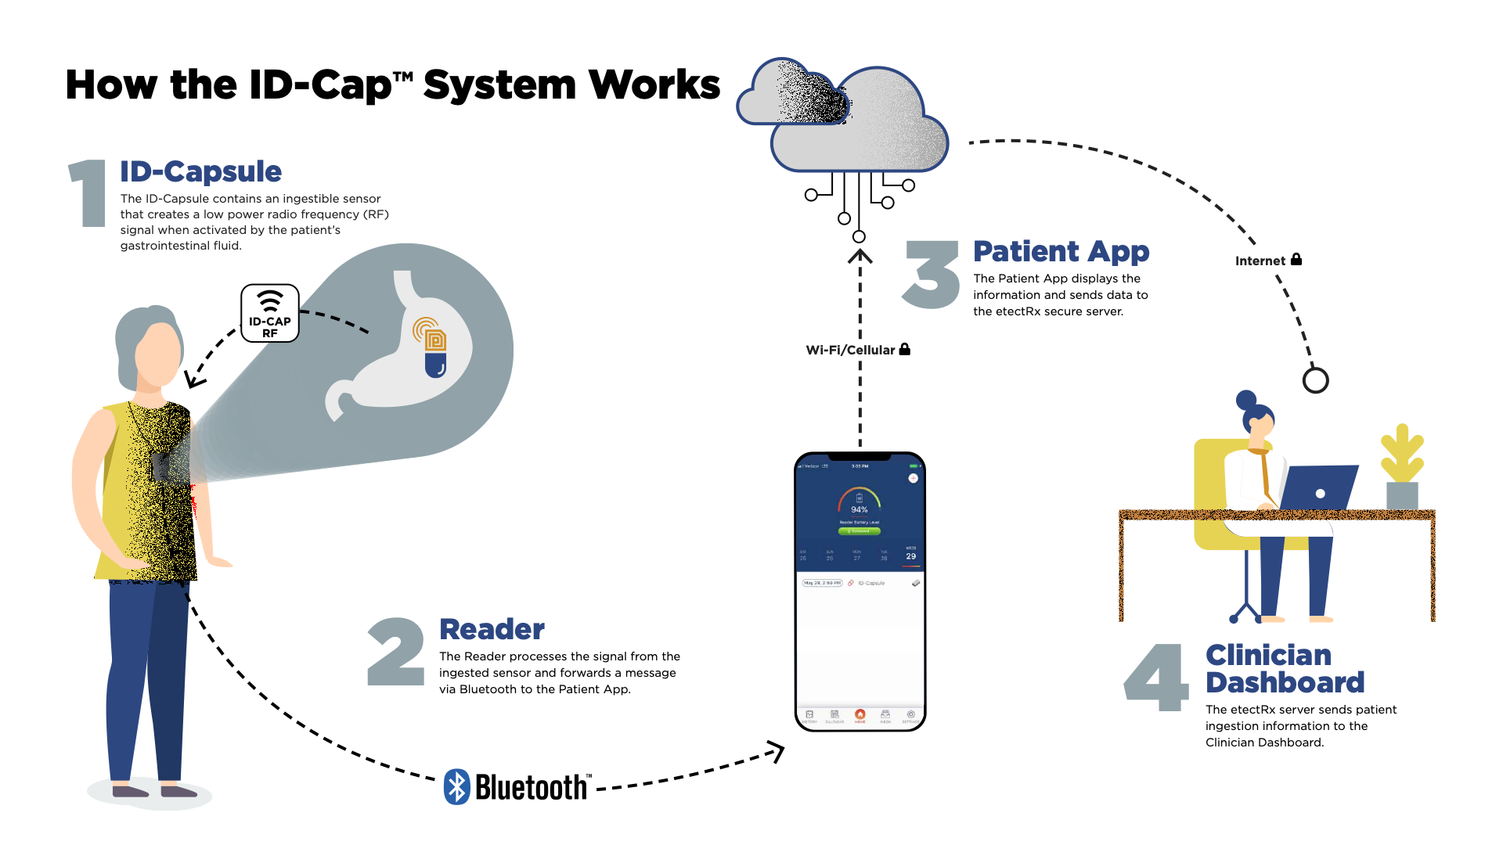
Courtesy of EtectRx

Slide 10
In SA, there is general acceptance of the use of adherence measurement technology; smart pillboxes (an indirect measure) are currently being employed in Cape Town, SA and have been used in prior research. In response to the need to better measure adherence, and the potential appetite to accept digital health tools as adherence supports, we sought to:
Specific Aims
Understand qualitative facilitators and barriers to operation and use of the DPS for ART adherence measurement among pregnant and postpartum people in SA

Slide 11
Method

Slide 12
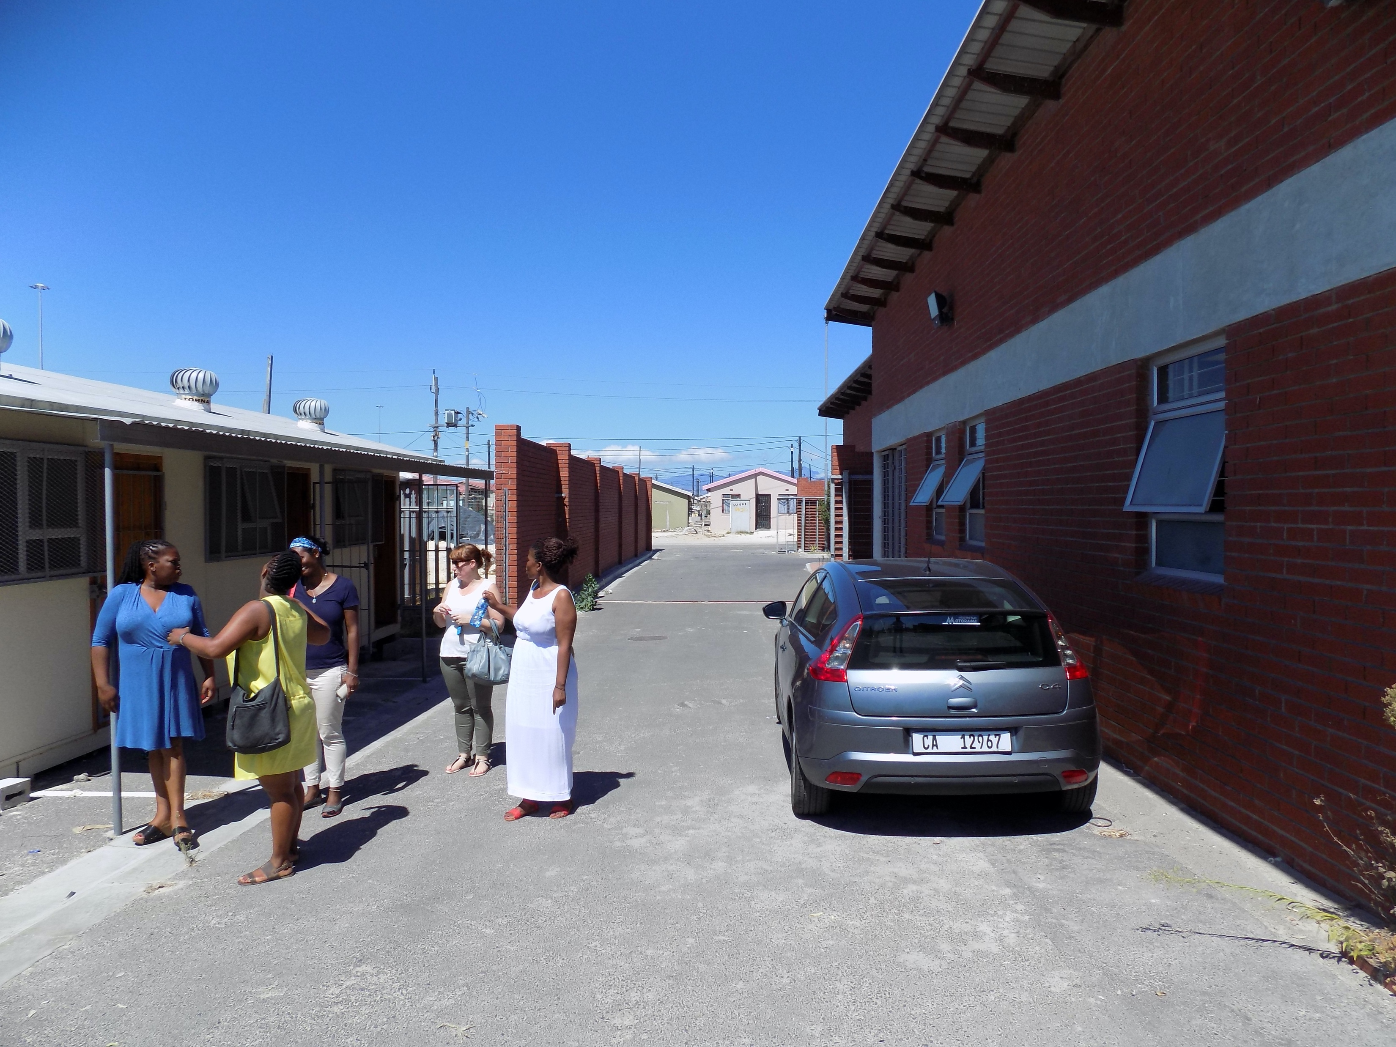
Participants
Pregnant and postpartum PWH were recruited from primary care clinics providing HIV and perinatal care in Khayelitsha, South Africa (N=8)
01
Participants engaged in a quantitative assessment and an individual qualitative interview
02
Interviews were conducted primarily in isiXhosa and translated to English for analysis
03
Notes:
Khayelitsha is a peri-urban settlement outside of cape town that was created during the apartheid era for the purposes of racial segregation

Slide 13
Assessments
Demographics
- Gender, sex, race, age, income, education, employment status, pregnancy status, number of children, cell phone ownership
01
Potential facilitators/barriers
- HFIAS, CES-D, SPAN, WHO-ASSIST Lite, IPV, ART adherence, MTUAS
Williams et al., 2008; Radloff, 1977; Coates et al., 2007; (Nolen-Hoeksema and Morrow, 1991; Humeniuk and World Health Organization, 2010; Saunders et al., 1993; Gámez et al., 2011
02

Slide 14
Analyses
We utilized rapid qualitative analysis techniques to explore preliminary attitudes toward DPS and to explore facilitators and barriers of potential future use
The qualitative interview guide included the following topics: - experiences during pregnancy and postpartum - medication adherence - attitudes toward DPS - messaging and privacy preferences

Slide 15
Results

Slide 16
Variable | N (%) | Variable | Mean (SD) [range]
Cisgender Woman | 8 (100%) | Age (years) | 29.25 (5.37) [24-38]
Black | 8 (100%) | Monthly Income (Rand) | R2,200 (R2,100.3) [R0-R6,000]
Heterosexual | 8 (100%) | Monthly Income (USD) | $117 ($111) [$0-$319]
Own a cellphone | 8 (100%) | # Missed doses in past 30 days | 6.13 (9.72) [1-30]
Pregnancy Status
Pregnant | 7 (87.5%)
Post-partum | 1 (12.5%) | Number of children | 2 (1.22) [1-4]
Have children before
Yes | 5 (62.5%) | Variable | N (%)
No | 3 (37.5%) | Education
Employment Status |  | Grade 9 | 1 (12.5%)
Unemployed | 6 (75%) | Grade 10 | 2 (25%)
Casual employ | 2 (25%) | Grade 11 | 4 (50%)
Seeking employment | 3 (37.5%) | Grade 12 | 1 (12.5%)

Slide 17
Participant Characteristics
Variable | N (%) | Variable | Mean (SD) [range]
Food Insecurity |  | Depression (CES-D) | 9.88 (5.30) [4-18]
Food secure | 2 (25%) | PTSD (SPAN) | 4.57 (4.20) [1-13]
Mildly food insecure | 0 (0%) | MTUAS positive | 4.02 (.54) [3-4.67]
Moderately food insecure | 3 (37.5%) | MTUAS anxiety | 3.38 (.68) [2-4]
Severely food insecure | 3 (37.5%) | MTUAS negative | 2.96 (.42) [2.67-3.67]
Moderate tobacco use | 1 (12.5%)
Moderate alcohol use | 2 (25%)
High cannabis use | 1 (12.5%)
Experienced intimate partner violence | 5 (62.5%)
Notes:
CESD cut = 20
SPAN cut = 5

Slide 18
“It would make a lot of difference. As you explained before, like how it works, it will make a huge difference. Like me as well. I forget to take the pills, I was forgetting to take the pills and, um, some people that that can go to the clinic, or they can go to the clinic and and work, it would help a lot.”
Initial reactions to DPS:
Digital pills viewed as initially helpful by reducing forgetting and improving accountability
“I think it's right, it's going to help us a lot and you will also feel bad if you don't take your pill on time. Because something that's monitoring you isn't nothing that's going to prevent you from taking your medication you will now take it on time and will leave this thing of lying and saying that we took the pill and we didn't even will help the clinic not have to always check your viral loads to take the blood to check if you are still taking your pill correctly, so it will show up there that everything is going according to plan... It's fine. Shame oh, I want it on my side.”

Slide 19
Initial reactions to DPS:
Concern about size of the digital pill capsule
“I was just shocked about the size like being big… I would say that maybe the one that I have because it's white, it doesn't look as big because this one is blue. So it looks like it's big.”

Slide 20
“I feel like it would be helpful a lot because it tells you that you have taken your pill. So what I love a lot about the digital, it tracks it tracks that you've taken it today and the week how did you go? So it would it would help me a lot to take my pills on time even my baby to be like healthy... What would encourage me to take it because I want to see the results.”
Thoughts about using DPS during pregnancy/post-partum:
Digital pills are trustworthy and would help protect their baby by improving their adherence
“It can be trusted because it comes from the doctor so it might not have any dangers… I would say that it would motivate me knowing that I am pregnant and the fact that I'm going to be okay so that would make me want to take the digital pill.”
“If it's going to protect the baby that is one thing that would motivate me.”

Slide 21
Thoughts about using DPS during pregnancy/post-partum:
Concerns about safety of digital pill for baby
“I don't like what it contains, like that thing. Like that paper. I'm scared that it will remain in my stomach… Is it not going to go to my baby? ... Maybe when I'm pregnant for the second time, then it would be something that was around for a long time tested.”
“I will be scared because they say that the child shares with the mother. I'm scared of that paper because it might not come out of me just goes straight to the child.”
“I'm scared of the sensor… I am afraid brother because inside I just think what it is going to do on the inside…”

Slide 22
Attitudes toward wearing the reader:
Wearing the digital pill reader for several minutes per day is acceptable
“So the sensor is not is not dangerous. So I wear it when I'm taking the pill right? And then I put it aside not wear it all the time… So I don't really mind… Yes, I would use it… Yes, I wouldn't want to wear the whole day. So, what's nice is that you just wait three to five minutes until it takes the pill and then you can take it off. And I don't have a problem with it.”

Slide 23
Attitudes toward wearing the reader:
Concerns about wearing digital pill reader include safety and charging
“If it was like your phone, it was going to be easy. But if you charge it, then it's going to be a problem because we have load shedding. So we don't have that problem. Imagine if you have to eat to take it and then it's Fletch, the battery's low, then you can't use it?... Where? because here we have electricity that just disappears for about three days, then you have to go and charge it somewhere else. If you ever have a car maybe then you might be lucky then you can charge it in your car.”
“I'm just scared of being robbed I don’t want to lie. You see it… it will make people look at you. But I will take my pill but it's going to be grabbing attention.”

Slide 24
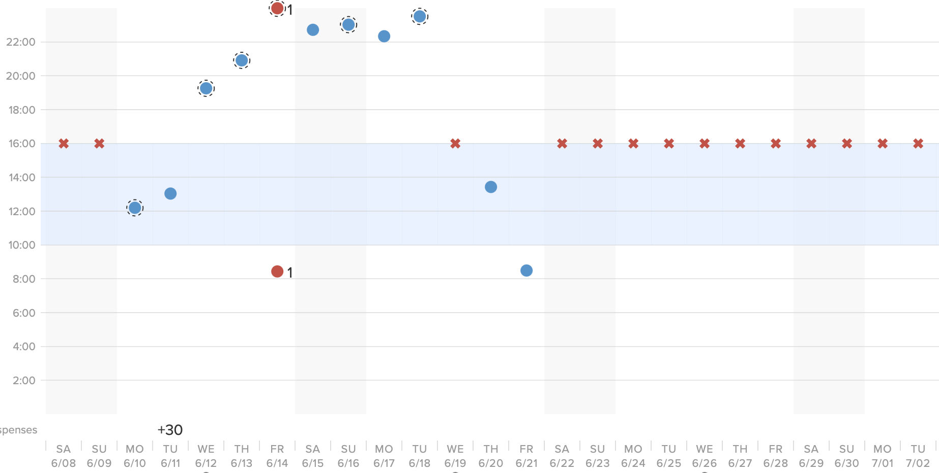
Notifications about adherence:
Notifications reviewing adherence were acceptable, but participants varied in desired frequency
“Every day, I'd want to see myself defaulting… It's motivating to get this, you get it's like getting a pat on the back that you're doing well, continue. It's it's not easy when you don't have people supporting you. So it's good.”
“Me getting a month notification is yes. Maybe being sent a message for previous month I would feel good. I'll feel good that I'll be told that I've been taking my medication correctly.”
Inconsistent timing of doses leading into frank nonadherence

Slide 25
DPS Smartphone application:
Checking adherence and receiving notifications via the smartphone app is acceptable
Concern about airtime/data:
“How do you access the app? Is it free? Because we don't have money for data. But it will be good that I can know even those messages they can come through and then I can check for myself that would be fine.”
“The app will be very helpful, I'll be happy to see my notifications on the app. Not messages only. So the app will also be helpful.”
“Yes, that would be a good thing. Yeah, so that no one can see it. Not everyone can see it. Yes. So that I'm the only one who can open the message without me then there's no one that can open the message. That would be a good thing.”

Slide 26
“Now there's no problem I don't have, I don't have a problem because the information is needed. I would love everything to be there in the folder as well, I don't I don't have a problem with that. As long as it's safe. And you also have a pin. And you don't have an someone's name there as well... I would say you guys plus my doctor and the receptionist that works here. Because sometimes the results they do reach them because sometimes they are the ones who put the results on the folder. So I don't have a problem not the security's not the cleaners though.”
Attitudes toward healthcare or research team accessing adherence data:
Acceptability of doctors and healthcare staff to access digital pill data, especially with added security features
“My doctor… Because I already have my information because they know my information like the one that I go to not someone else, or not someone else like the nurse”
“As long as you don't use the information to mock me. You got to help me I don't care… I don't want anyone else without consent to see my information… Someone external”

Slide 27
Attitudes toward others accessing adherence data:
Acceptability of family members accessing digital pill data, but concerns about friends or others
“I think it's my doctor… people are too judgmental at the end, you don't know who to trust"
“don't have a problem because I don't hide it. Even them, I will tell them even the numbers, even if they can say that they want to add someone else where you can get these messages, I can still choose someone here in the house. So that they can remind me or they can check if everything is done correctly.”
“My family can see but not my friends that they don't have to say that.”
“Yes, my family can see there's not a problem. Friends no.”

Slide 28
“I would feel good, because now I know. You can't just use something that you don't know. It's good to use something that you know, so that it can be easy for you, even when you are using it so that you can take your pills on time. And you know how to wear the reader and everything... I wouldn't see it any problem. Everything is easy. Now no one has to be taking pains or stress about going to the clinic. Afraid of the needles, some people don't like needles, so it would be just easy for anyone to do that.”
Attitudes toward using digital pill:
Positive attitudes toward use of digital pills during pregnancy/post-partum
“I wouldn't have a problem. Because it's something that would make me take my pills on time.”
“I’ll feel okay. Because it's going to help me and protect my life. That must come. We'll get used to it as well.”
“I wouldn't have a problem if I used it the way it's supposed to be used.”

Slide 29
Attitudes toward using digital pill:
Concern about adverse effects of digital pills and the use of the neck-worn reader as barriers to use
“Since it's still new and no one has it I don't want to lie. Because we'll see how long is taking with you? Is it wasting your time and you taking it a certain time? And that pin inside like is it going to affect you? Or maybe if it's going to make you have diarrhoea or what we'll see by then for now, I don't want to lie I don't want to say anything.”
“Yes, the reason is that thing on the on the neck.”

Slide 30
Discussion

Slide 31
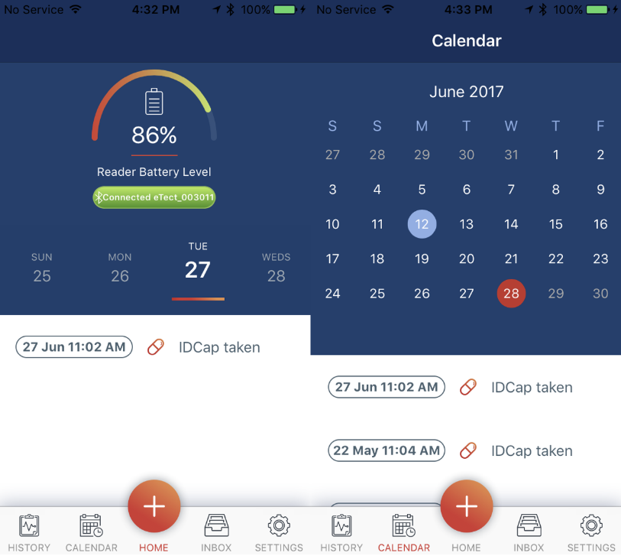
Most participants were accepting of the Digital Pill System, highlighting:
Potential for improving adherence by enhancing reminders and providing a summary of recent adherence
01
02
Increased accountability with clinic providers and potential for reduced frequency of viral load assay and attending the clinic
03
Perceived benefit of enhancing the health of their child

Slide 32
Wearing the reader and receiving notifications via message or app were acceptable
A neck-worn reader for several minutes per day is acceptable
01
02
Notifications about adherence and reminders for adherence were acceptable, but participants varied in desired frequency. This highlights importance of customizable settings for each user.

Slide 33
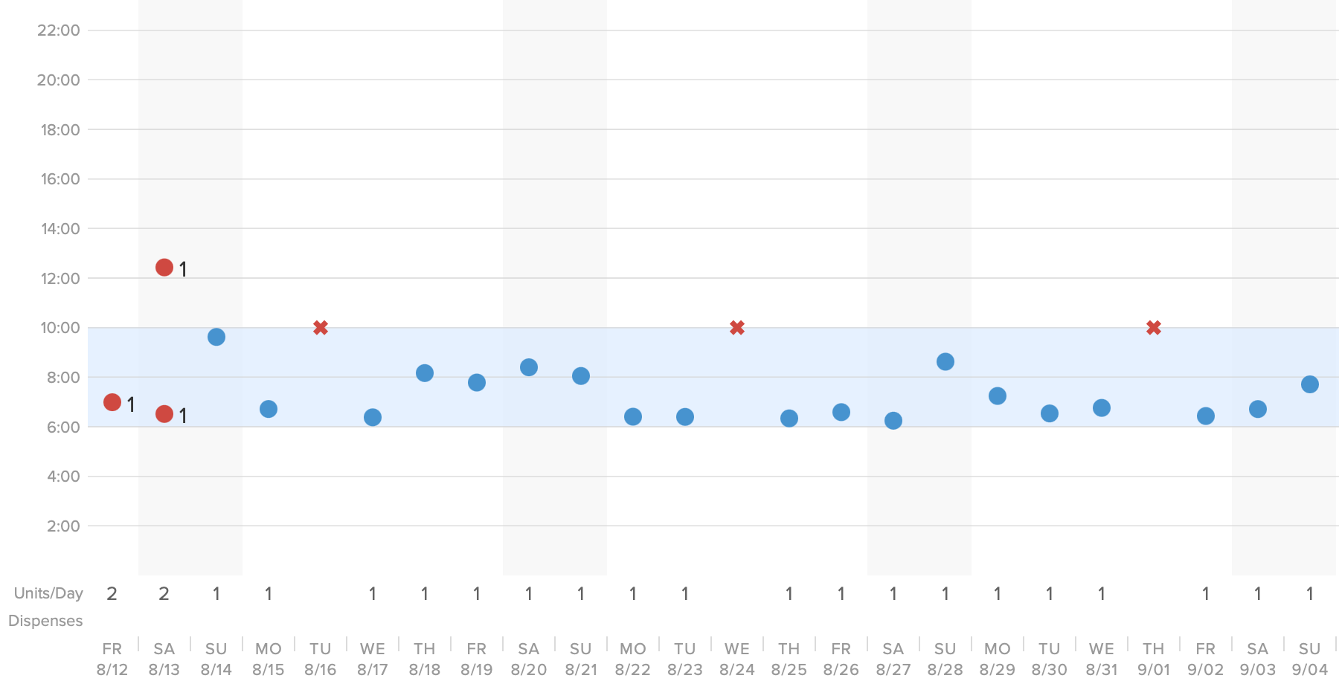
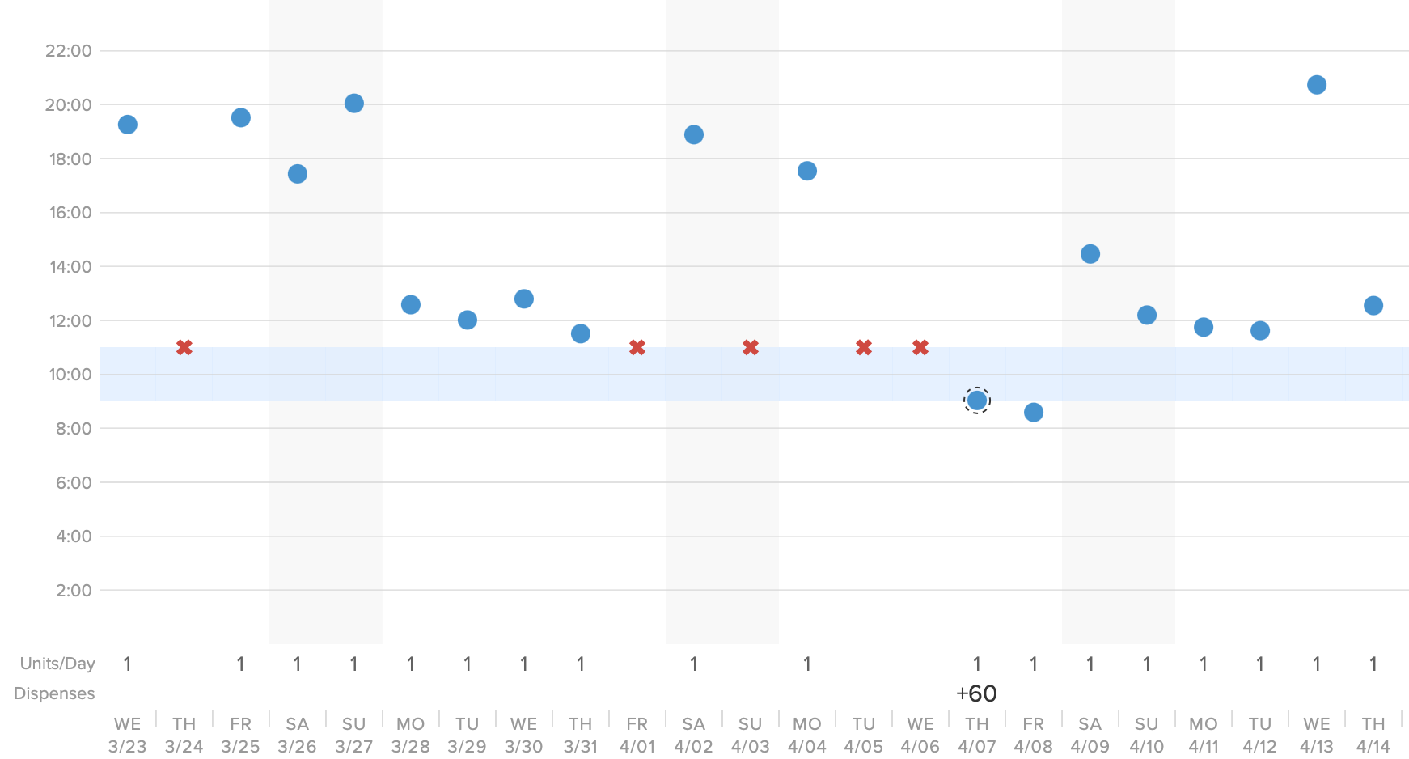
Mostly acceptable for researchers, doctors, other legitimate healthcare staff, and family to accepts DPS data
Participants highlighted the importance of having a legitimate medical need to access DPS data, and the use of added security features (like login pins)
01
02
Trusted family members having the ability to access data was viewed as an enhanced form of social support, but participants emphasized the importance of autonomy and choice in selecting individuals with whom to shared data

Slide 34
Concerns about the DPS included safety, potential adverse effects of the sensor on mother and child, and the size of the pill
Education components regarding adverse effects and safety will be important in future DPS roll-out
01
02
Need to emphasize autonomy and personal choice in use of DPS. Due to the novel nature of this technology, participants may need several introductions to DPS

Slide 35
Conclusions
Pregnant and post-partum PWH in South Africa who were presented with an introduction to a DPS were generally accepting of potential future use of the DPS.
Perceived benefits of the DPS included improved adherence and health of mother and child, more efficient healthcare visits, and increased information available.
Participants also indicated concerns about safety that may be require in-depth education about the DPS.
Results also emphasized the importance of customizable settings regarding frequency of notifications and sharing of DPS-generated adherence data.

Slide 36
Limitations
These qualitative data are preliminary, were collected among a small (N=8) sample of pregnant and post-partum women in an ongoing study. Although participants were introduced to the DPS multiple times during this cross-sectional interview, including via an educational video and by allowing participants to handle sample digital pills, these data are based on responses to hypothetical questions about DPS, rather than their actual experience using DPS.
These data are from a pilot study to provide preliminary data to inform potential future use of DPS among PWH in South Africa.

Slide 37
Thank you! Enkosi kakhulu
The authors also wish to thank and acknowledge City of Cape Town Department of Health for their support and for granting us access to their clinics. Thank you also to the staff, patients, and Community Advisory Boards at the respective clinics for their time, effort, and support.

