Slide 1
Preliminary Qualitative Data from the MyTPill Study
HICSS January 3rd 2024
**NIH funded grant number R01DA047236-04
in partnership with etectRx**

Slide 2
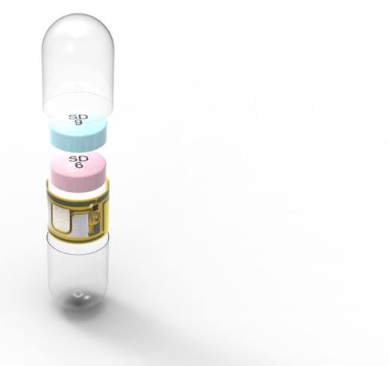
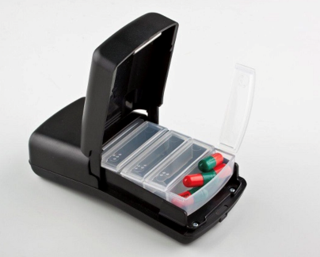
MyTPill: A novel strategy to monitor antiretroviral adherence among HIV+ people who use substances
Controlled crossover study designed to compare ART Adherence in substance users. Each participant randomized to use each adherence device for 90 days – after which they will be asked a series of questions regarding their experience with each device and overall opinions.
WisePill
ID-Cap
Vs.

Slide 3
Overview
MyTPill is a NIH-funded, 5-year trial comparing two technologies for medication adherence. MPIs Edward Boyer, MD, PhD (OSU); Adam Carrico, PhD (FIU)
etectRx is a digital health/medical device company and the manufacturer of the ID-Cap System™
The ID-Cap System is:
Class II medical device
Classified by FDA as an ingestible event marker (IEM)
Available by prescription only
The ID-Cap System consists of 4 parts……

Slide 4
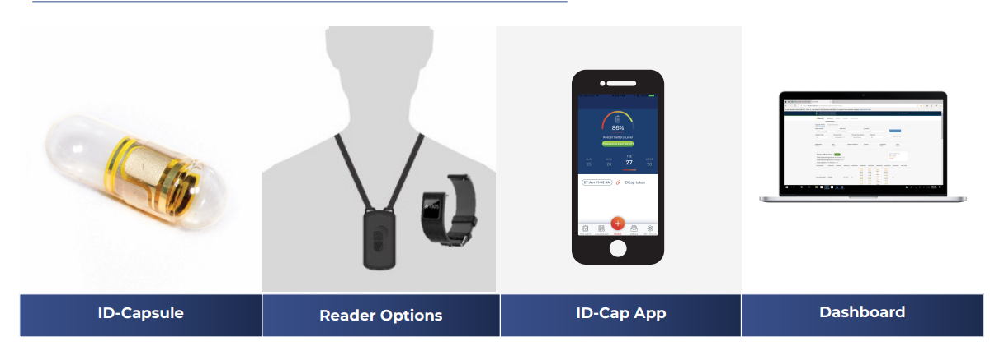
4 Components of ID-Cap Adherence System

Slide 5
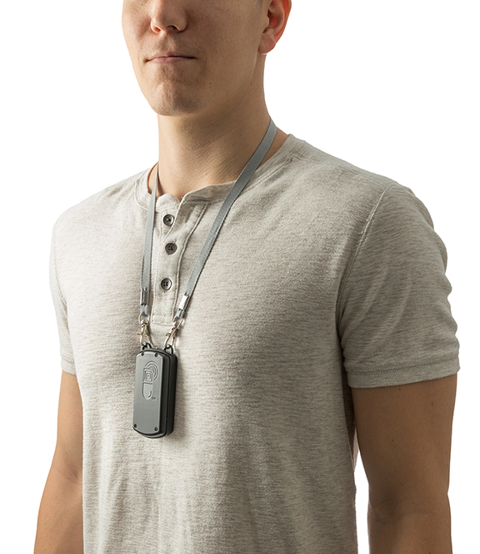
ID-Cap Reader

Slide 6


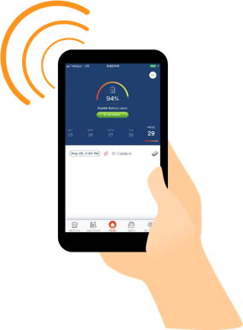


Medication Adherence with ID-Cap System
5
Research staff remotely monitors patient therapy using the ID-Cap Dashboard
Real time reporting of ingestion events
Alerts to missed events
Automatic reminder messages to reduce missed doses
Confirmation messages in response to ingestions
View of individual patients or groups
1
https
Study drug is encapsulated by the Pharmacy.
Performed by etectRx or the Research Pharmacy.
Delivers the study medication and reader to the site for dispensing to the participant.
4
etectRx Servers
Secure Cloud-based Storage
Patient’s Ingestion Log
Reader status reports
HIPPA Compliant
https
Wi-fi/Cellular
3
2
ID-Cap App
Reports and displays ingestion event history
Displays reminder or confirmation messages
Allows user to enter ingestion event manually
Provides updates on status of Reader
Available for iOS and Android
The patient takes the encapsulated medication.
The ID-Capsule is activated by gastric fluid
Transmits a digital message from the stomach
The wearable ID-Cap Reader receives the message and forwards it to the mobile app

Slide 7
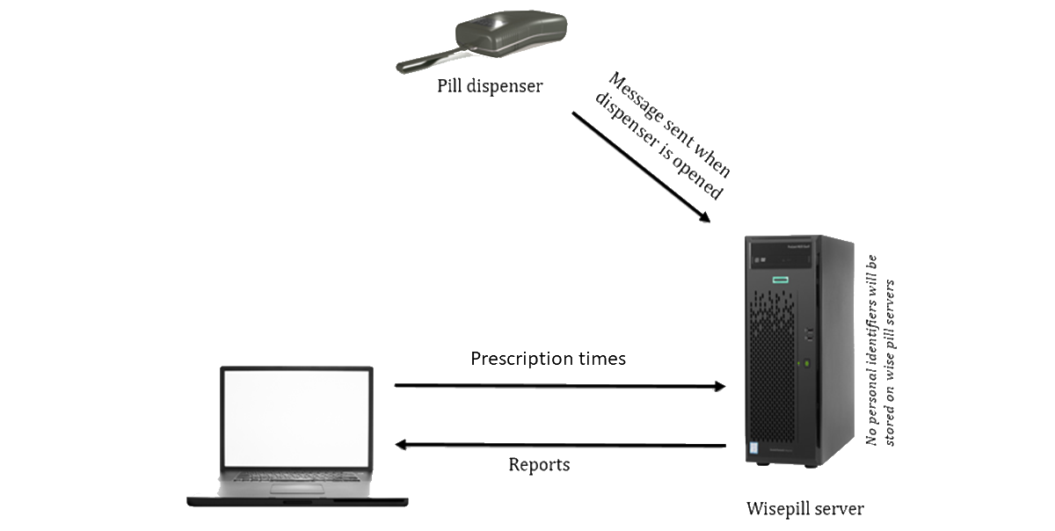
Medication Adherence with WisePill
Figure above from:
Lucero R, et al. JMIR Form Res 2020;4(2):e14888 doi: 10.2196/14888

Slide 8
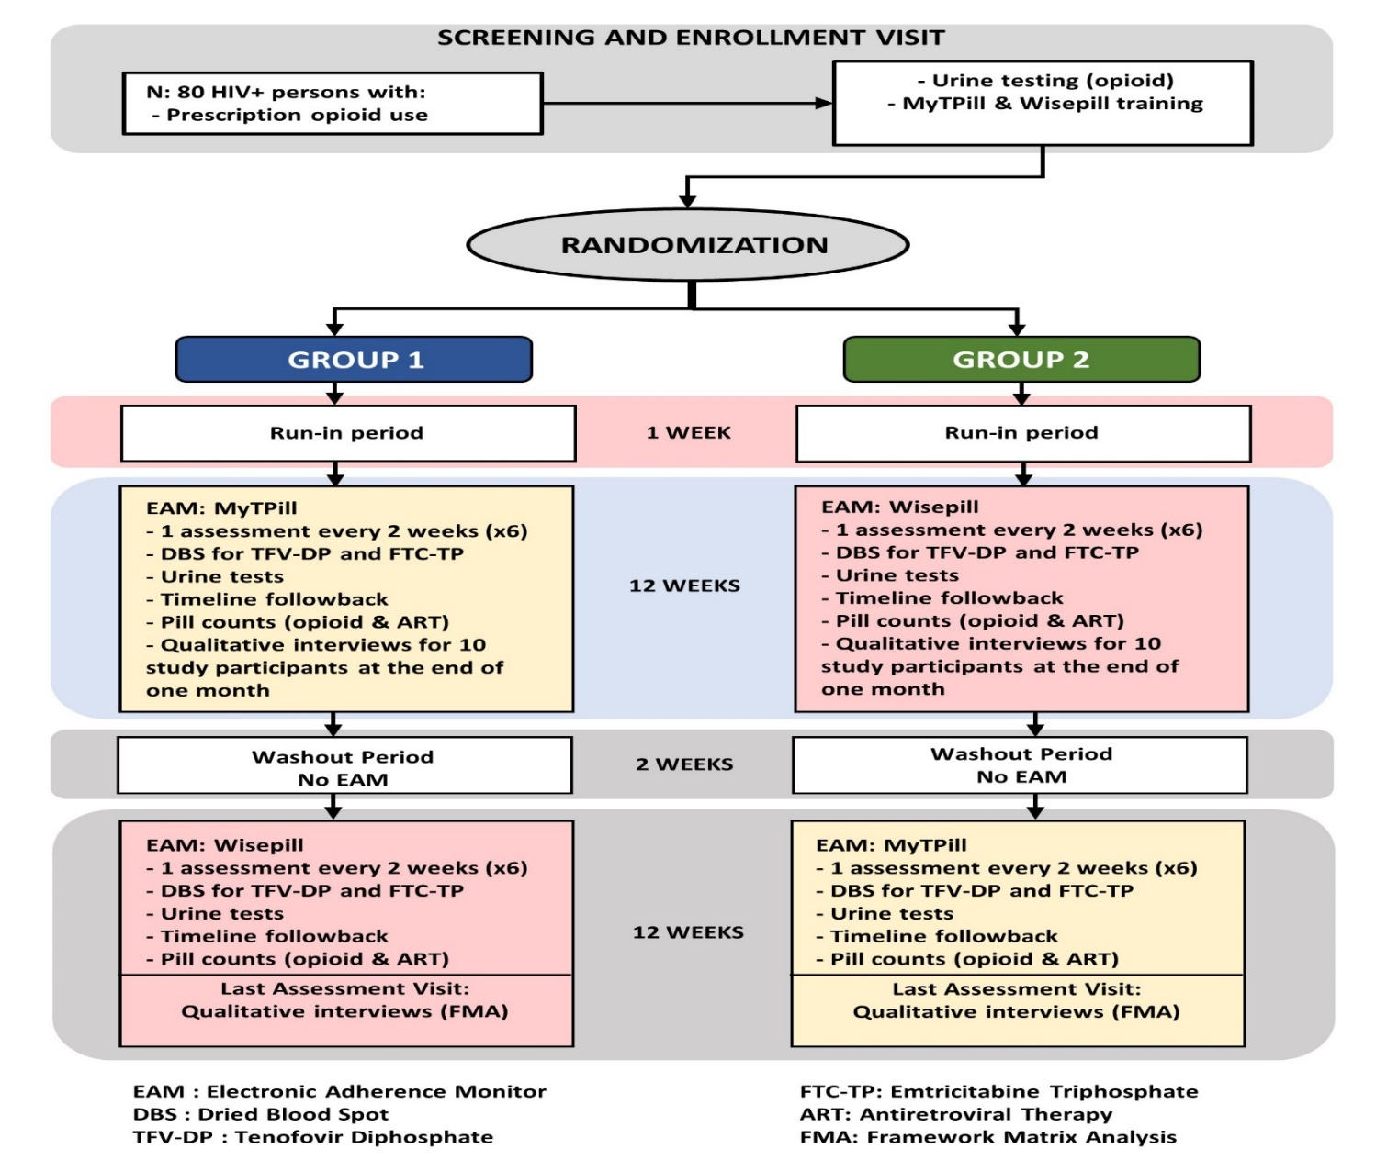
MyTPill 27-Week Study Visits & Study Activities

Slide 9
MyTPill Study Qualitative Data
Each participant participates in 2 interviews, each lasting approximately 20-30 minutes
  3 months: after 90 days of use of 1st adherence monitoring system (ID-Cap System or WisePill)
  6 months: after 90 days of use of the 2nd adherence monitoring system (WisePill or ID-Cap System)
    6-month interview includes:
      Experiences post completion of the 2nd 90-day period to determine:
        Comparison of ID-Cap System and WisePill medication monitoring devices
        Preference for one or the other
        Feedback on study experience
  Withdrawn participants invited to an interview for feedback on experiences to date

Slide 10
Participant Interviews Analyzed as of December 2023
10 total participants; 15 interviews
  5 ID-Cap System 3M interviews
      2 also completed 6M WisePill + comparison
  4 WisePill 3M interviews
      3 also completed 6M ID-Cap System + comparison
  1 Discontinued ID-Cap System participant
  8 ID-Cap System experiences
  6 WisePill experiences
  5 Comparisons
3M ID-Cap | 6M WisePill & Comparison |  | 3M WisePill | 6M ID-Cap & Comparison |  | Discontinued
PID 4 | PID 4 |  | PID 3 |  |  | PID 8 (ID-Cap)
PID 2 |  |  | PID 1 | PID 1
PID 6 | PID 6 |  | PID 5 | PID 5
PID 9 |  |  | PID 7 | PID 7
PID 10

Slide 11
ID-Cap System Experience
  Qualitative questions included:
    What they liked Most/Least about the ID-Cap System
    Experiences with the ID-Cap System including the ID-Capsule, Reader, and ID-Cap App
    Did participants find ID-Cap System easy to understand/operate?
    Describe a typical day using the ID-Cap System.
    Would they consider using the ID-Cap System if available?
    Thoughts on ID-Cap App overall usability

Slide 12
WisePill Experience
Qualitative questions included:
  What they liked Most/Least about WisePill
  Their experiences with the pill bottle device
  Did participants find WisePill easy to understand/operate?
  Describe typical day using WisePill
  Would they continue to use the WisePill device if it was available as a choice for adherence.

Slide 13
Qualitative Analysis
Audio recorded (Miami)
Transcription and cleaning (Ohio)
Framework Matrix Analysis and Review (RI)
  Data reduction technique for large qualitative data sets
  Particularly useful for health services work
  Largely deductive but leaves room for inductive data
  Data is charted into a matrix focusing on each participant’s answer to key questions
  Easy to share with a large team
  Done in near real time
  Track summaries and recommendations

Slide 14
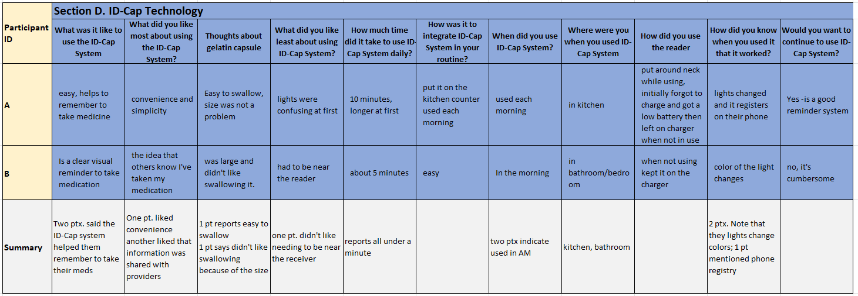
Framework Matrix (not actual data)
Rosen, et al. (2023). Use of Framework Matrix and Thematic Coding Methods in Qualitative Analysis for mHealth: The FluidCalc app. International Journal of Qualitative Methods, June 2023.

Slide 15
7 Total Matrices
ID-Cap System 3-month interview
WisePill 3-month interview
ID-Cap System 6-month interview
WisePill 6-month interview
ID-Cap System/WisePill 6-month comparison
WisePill/ID-Cap System 6-month comparison
Discontinued participant reflections

Slide 16
Discontinued Participant
Only one interview
ID-Cap System user
Unable to continue using the device due to personal circumstance
Device use did not play a role in discontinuation
Had no concerns about taking the pill/using the device
Found it “very convenient” and easy to use

Slide 17
ID-Cap System Experiences
3 month – 5 participants
  Easy to use; convenient, like taking any other pill; interesting/fun;
  LIKED MOST: app, reader/lanyard (x2);
  LIKED LEAST: taking technology with them was inconvenient; reader/lanyard; charging issues;
  READER: took up to 10 minutes to register, it’s not subtle; “invasive”, easy to use, “complicated”;
  All used the app to check adherence and make sure the system worked, liked seeing the dates taken and log of ingestion history.
  All take their pills, two say ID-Cap System helps them be more aware/have better adherence—learned something about their routine
  CHALLENGES: after midnight = the next day
  SHARING DATA: no concerns; comfortable sharing with medical personal, clinicians, pharmacists but not with family members
6 month – 3 participants
  It’s like taking any other pill; it’s a little hard to swallow
  LIKED MOST: ability to monitor their medication with the lanyard and app
  LIKED LEAST: blinking lights were confusing
  READER: challenging to see the info on their phone app
  Used the app to check their own adherence
  All take their pills regularly
  CHALLENGES: not charging when not stored on the charger itself, using the app
  SHARING DATA: no concerns from 2 ptx to have it shared in the study, the third didn’t like sharing data but said it’s necessary and keeps them healthy; comfortable sharing with medical personal, but NOT pharmacists, family, or caregivers which would be an “intrusion”

Slide 18
WisePill Experiences
3 month – 4 participants
  A good experience, easy to understand and operate, simple to use
  LIKED MOST: easy to open, reminder to take pill, felt safe to have around kids because it’s NOT easy to open
  LIKED LEAST: changed the time they took their meds, nothing and had to remember to use it
  All take their pills as prescribed, one indicated forgetting few times
  CHALLENGES: taking meds after midnight and again later that day registers two doses on that day.
  SHARING DATA: one didn’t realize study team members would see their adherence information; no concerns with sharing with the study team; comfortable sharing with medical personal, clinicians, pharmacists and (one participant) with family members because that information is already shared with them by the participant
6 month – 2 participants
  Easy to use and understand, helps with adherence
  LIKED MOST: convenience, it registers with the system when you open it
  LIKED LEAST: nothing
  All take their pills, one says adherence is better since using WisePill
  CHALLENGES: didn’t know if the system worked (1 participant)
  SHARING DATA: it was fine, neither had any concerns and felt their data can go to medical personnel, but not others

Slide 19
ID-Cap System vs. WisePill Preference
WisePill -> ID-Cap System
  1 WisePill, 1 ID-Cap System
ID-Cap System -> WisePill
  2 WisePill, 1 ID-Cap System

Slide 20
Comparisons
WisePill -> ID-Cap System – 3 participants
  Two Wisepill choosers felt it was easier overall; opening the bottle helped them remember
  ID-Cap System helped because the app gives a visual look at adherence; and because the larger pill itself made taking it memorable
  2 participants would prefer no adherence system to either WisePill or ID-cap
ID-Cap System -> WisePill - 2 participants
  ID-Cap System was more complicated/more of a process because it had several steps; it probably helped with adherence more because you had to remember more to use it (WisePill preferer)
  ID-Cap reminded them to take their meds more; “I see the light switch into white, I just felt that, that it was working there, that it was on the system already for sure.” (ID-Cap System preferer)
  Both participants preferred either ID-Cap System or WisePill to using no medication reminder system
  Both systems help with medication adherence, but in different ways:
    With ID-Cap System you knew the medication was effective when the light started blinking;
    WisePill reminds you to take your medication when you see the flashing light

Slide 21
Thank You to the MyTPill Study team
  University of Miami and Florida International University
    Adam Carrico, Michael Viamonte, Omar Valentin, Chelsea Henderson, Delaram Ghanooni, Hetta Gouse, Allan Rodriguez, Kathryn McCollister
  The Ohio State University
    Edward Boyer, Jennifer Frey
  The Miriam Hospital, Providence, RI
    Rochelle Rosen, Ryan Lantini
  Gilead Sciences
    Jessica Robinson, Bindu Warrier, Jarred Coffey
  etectRx
    Pamela Alpert, Chris Carnes

