Slide 1
Hawaii International Conference on System Sciences (HICSS)
January 3-6, 2024
Georgia Goodman, BS
Research Project Manager
Brigham and Women’s Hospital
Boston, MA, USA
Real-world implementation challenges associated with a digital pill system to measure adherence to HIV pre-exposure prophylaxis from two studies of men who have sex with men

Slide 2
Acknowledgments
Funding from NIH (K23DA044874, PI: Chai) and Gilead Sciences (ISR-17-1018, PI: Chai).
Tenofovir disoproxil fumarate/emtricitabine provided by Gilead Sciences.
No conflicts of interest to report.

Slide 3
HIV, PrEP, & substance use
HIV is an ongoing public health crisis, with men who have sex with men (MSM) at high risk ¹⁻²
Oral pre-exposure prophylaxis (PrEP) is highly effective for HIV prevention, but depends on adherence ³⁻⁴
Substance use disorders (SUD) increase risk of PrEP nonadherence and HIV infection ⁵
¹ CDC. (2022). HIV Surveillance Report, 2020 (Vol. 33). ² CDC. (2021b). HIV Surveillance Report, 2019 (Vol. 32). ³ Anderson, P.L., Glidden D.V., & Liu A., et al. (2012). Emtricitabine-tenofovir exposure and pre-exposure prophylaxis efficacy in men who have sex with men. Science Translational Medicine, 4(151), 151ra125-151ra125. ⁴ Doblecki-Lewis, S., Cohen, S., & Liu, A. (2015). Clinical treatment options infectious diseases: Update on PrEP implementation, adherence, and advances in delivery. Current Treatment Options in Infectious Diseases, 7(2), 101–112. ⁵ Grov C et al. (2019). Determining the roles that club drugs, marijuana, and heavy drinking play in PrEP medication adherence among gay and bisexual men: Implications for treatment and research. AIDS and Behavior, 23(5), 1277–1286.

Slide 4
Measuring adherence
Current strategies:
Indirect: self-report, pill counts of unused medication, pharmacy refill data, smart pill bottles ¹⁻³
Direct: in-person or video directly observed therapy, pharmacological measures of blood, urine, or hair ¹⁻³
Key disadvantages include cost, access, and scalability, and recall and social desirability bias
¹ Bell & Haberer. (2018). Actionable adherence monitoring: Technological methods to monitor and support adherence to ART. Current HIV/AIDS Reports, 15(5), 388–396. ² Castillo-Mancilla & Haberer. (2018). Adherence measurements in HIV: New advancements in pharmacologic methods and real-time monitoring. Current HIV/AIDS Reports, 15(1), 49–59. ³ Spinelli et al. (2020). Approaches to objectively measure ART medication adherence and drive adherence Interventions. Current HIV/AIDS Reports, 17(4), 301–314.

Slide 5
Digital pill systems (DPS)
Enable direct, real-time adherence measurement via:
Digital pill: Gelatin capsule with integrated radiofrequency emitter, which overencapsulates medication
Reader: Wearable device captures and forwards ingestion data via Bluetooth
Mobile app & dashboard: Displays ingestion data on-demand
Images courtesy of etectRx.

Slide 6
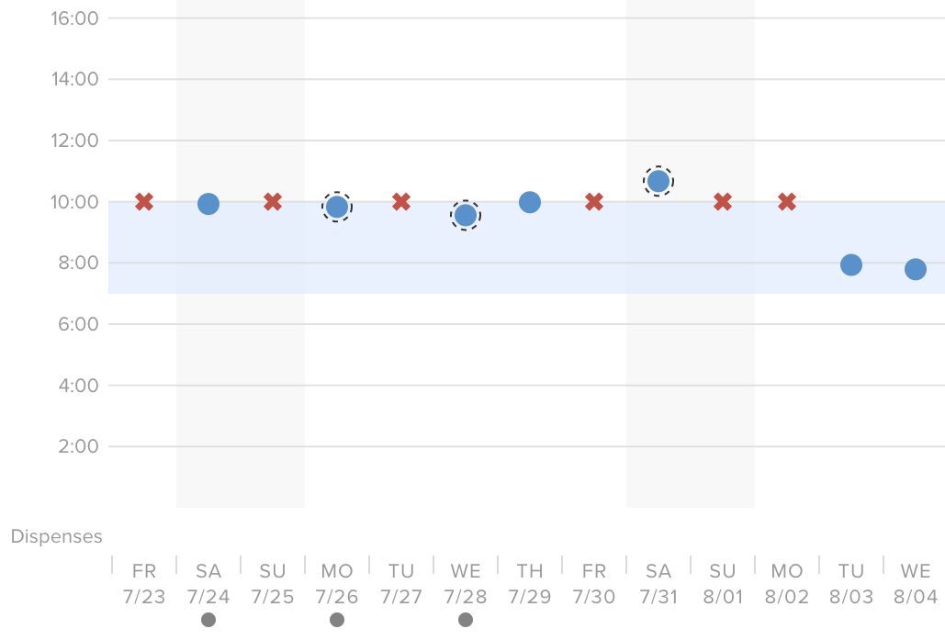
Sample adherence data
System-detected
Manually recorded
Missed ingestion

Slide 7
Aim of analyses
To examine the real-world operational challenges of DPS deployment for PrEP adherence measurement
Collated from two studies of HIV-negative adult MSM on oral PrEP with substance use (excl. alcohol)

Slide 8
Two PrEP studies
DigiPrEP (N=15): 90-day, single-arm, open-label, pilot demonstration trial to assess feasibility, acceptability, and accuracy of DPS ¹
PrEPsteps (N=23): 90-day pilot RCT to assess feasibility, acceptability, and potential effect of adherence intervention respondent to DPS data ²
¹ Chai et al. (2022). DigiPrEP: A pilot trial to evaluate the feasibility, acceptability, and accuracy of a digital pill system to measure PrEP adherence in men who have sex with men who use substances. JAIDS, 89(2), e5–e15. ² ClinicalTrials.gov. Development of Ingestible Biosensors to Enhance PrEP Adherence in Substance Users (PrEPSteps). https://clinicaltrials.gov/study/NCT03512418

Slide 9
Methods
Ongoing assessment of operational challenges
Ad hoc participant feedback (e.g., technological issues)
Gyroscopic data from Reader (e.g., lack of motion or charging)
Timeline followback discussions (e.g., context of missed doses)
Collated and analyzed operational issues, troubleshooting steps, technological solutions, and management strategies across studies

Slide 10
Sample characteristics (N=38)
37
Mean age
84%
Gay
68%
College degree or higher
White
71%
82%
Non-Hispanic or Latino

Slide 11
Results
Operational challenges
Technological issues
System errors
Participant operation
Sociobehavioral issues
Personal circumstances
Access to technology

Slide 12
Technological issues
System errors
Data delivery and display issues
Ingestion data not relayed to Reader, app, or dashboard
Duplicate ingestions displayed
Malfunctioning charging components
Charging pad
Power brick
Charging coil

Slide 13
Technological issues
Participant operation
Issues with Reader & charging
Did not charge Reader prior to ingestion
Did not wear Reader for sufficient time during ingestion
Did not correctly place Reader on charger or plug into outlet
Issues with Bluetooth pairing
Difficulty pairing Reader to phone via Bluetooth
Switched phones and did not re-pair Bluetooth
Turned off Bluetooth to save battery

Slide 14
Technological issues
Resolution strategies
Study team actions
Real-time troubleshooting via text, phone, or in-person
Replace malfunctioning components
Ongoing re-education and new training materials
etectRx actions
Identify and fix software bugs and manufacturing issues
Improve Bluetooth stability and automatic re-pairing
Add Bluetooth diagnostic info to app

Slide 15
Sociobehavioral issues
Personal circumstances
Financial constraints
Unable to pay for phone or data plan to use app
Change in routine, housing, or health
Travel
Homelessness or unstable housing
Hospitalization
Incarceration
Substance use

Slide 16
Sociobehavioral issues
Access to technology
Phone
Broke or misplaced phone during study period
DPS components
Broke or misplaced Reader during study period
Insufficient data plan or phone storage to use app
Internet or electricity
Relied on public Wi-Fi due to limited home internet
No access to electricity to charge Reader

Slide 17
Sociobehavioral issues
Resolution strategies
etectRx actions
Review internal Reader data to contextualize nonadherence
Study team actions
Additional remuneration or subsidized phone data plans
Charge Readers and connect to Wi-Fi at study visits
Re-education on proper DPS operation
Ongoing contact to support retention

Slide 18
Limitations
Small overall sample size (N=38)
Well-educated smartphone owners
Enrolled from community health center focused on LGBTQ+ research and clinical care
Frequency data not collected for operational issues, given overlapping nature of challenges

Slide 19
Key takeaways
While most successfully operated the DPS, operational issues requiring intervention were identified
Technological issues were largely anticipated and addressed with system updates and re-education
Sociobehavioral issues, e.g., housing changes and lack of technology access, were largely unanticipated and required innovative and ongoing solutions

Slide 20
Key takeaways
Many technological issues exposed underlying sociobehavioral challenges, which had a compounding effect on PrEP adherence and DPS use
Combination of direct feedback, DPS adherence data, and gyroscopic Reader data can help distinguish acute operational issues from long-term disengagement

Slide 21
Key takeaways
Effective implementation requires:
Robust training and supportive infrastructure
Manualized protocols for both anticipated and unanticipated challenges
Ongoing coordination with industry collaborators to anticipate, identify, and resolve issues

Slide 22
Authorship team
Peter R. Chai, MD MMS
Joanne Hokayem, BA
Rochelle K. Rosen, PhD
Brigham and Women’s Hospital
Boston, MA, USA
The Fenway Institute
Boston, MA, USA
Brown University
Providence, RI, USA
Tony C. Carnes, PhD
Charlotte Goldfine, MD
Kenneth H. Mayer, MD
etectRx, Inc. Gainesville, FL, USA
Brigham and Women’s Hospital
Boston, MA, USA
The Fenway Institute
Boston, MA, USA
Hannah Albrechta, MPH
Jasper S. Lee, PhD
Conall O’Cleirigh, PhD
The Fenway Institute
Boston, MA, USA
Massachusetts General Hospital
Boston, MA, USA
Massachusetts General Hospital
Boston, MA, USA
Pamela Alpert, BA
Edward W. Boyer, MD PhD
etectRx, Inc. Gainesville, FL, USA
Ohio State University Columbus, OH, USA

Slide 23
Georgia Goodman
ggoodman@mgh.harvard.edu
Questions?

